Slide 1
FASTAPI Development using Python on Cloud
FastAPI with Agentic AI on Cloud

Slide 2
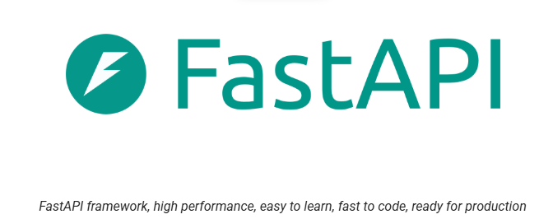
Overview of FASTAPI
FastAPI is a Python web-framework for building modern APIs.
Fast (Performance)
Fast(Development)
Features
Few Bugs
Quick & Easy
Robust
Standards

Slide 3
FastAPI Documentation
FastAPI is a web framework or building modern RESTful APIs.
Fast - Very high performance, on par with NodeJS and Go
Fast to code - Increase the speed to develop features by about 200% to 300%.
Intuitive - Faster code support , Less time debugging.
Robust – Designed to be automated Production ready code. With automatic interactive documentation.
Short – Minimize code duplication. Multiple features from each parameter's declaration.

Slide 4
FastAPI integration with Full Stack Architecture
FastAPI
​Web Page
Full Stack Application
Server
Handles all business logic for the application
Based on Two sets of API – OpenAPI and JSON Schema

Slide 5

FastAPI Documentary

Slide 6



Who has used FASTAPI?

Slide 7
Installation of Dependencies
Pip is the Python package manager.
Pip is used to install and update packages.
Use the latest version of pip installed.

Slide 8
Setting Up Virtual Environment
Start by new folder / directory called “FastAPI”
Within the pip check the dependencies that have been installed
Python already has an included dependency for virtual environments called venv.
Creating a new FastAPI environment as a virtual environment.
Activating out virtual environment to install our dependencies in

Slide 9
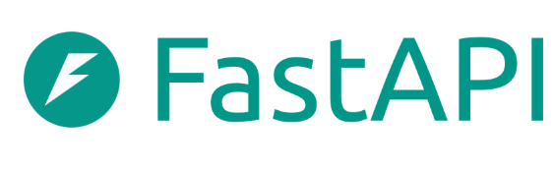
HTTP Request & Response
HTTP Request Methods
Web Page
Server
Create
POST
Read
Get
Update
PUT
Delete
Delete

Slide 10
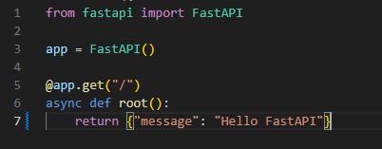
Creating FastAPI Application

Slide 11
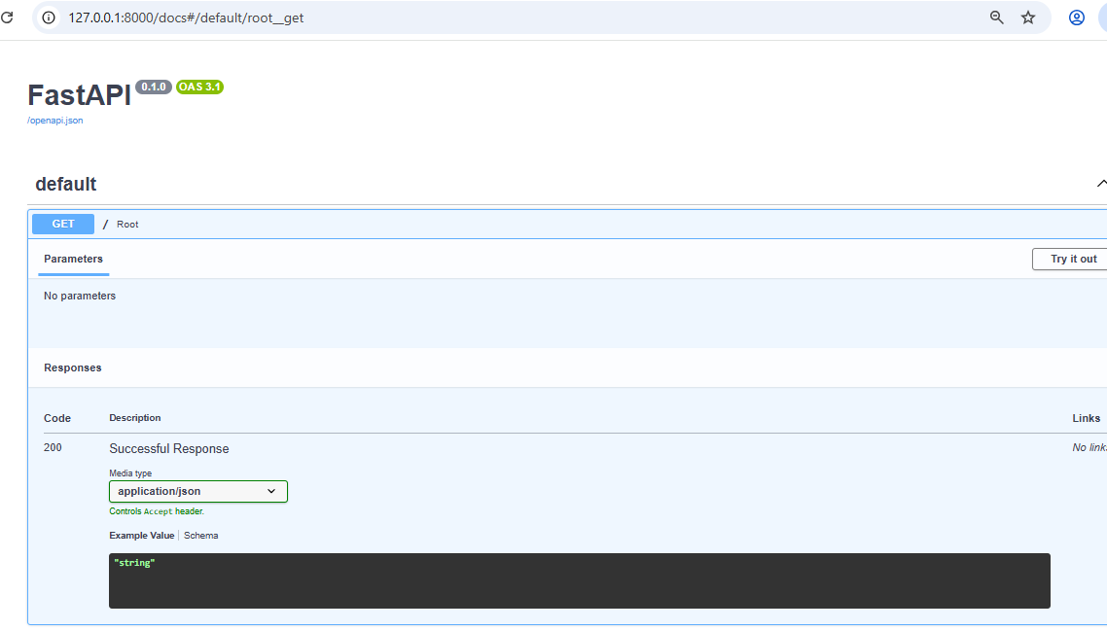
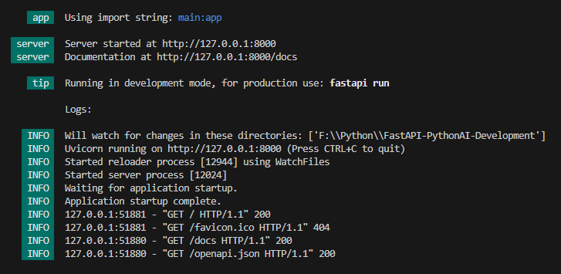
Running Your FastAPI App

Slide 12
Path Parameters
Path Parameters are request parameters which have been attached to the URL
Path Parameters are defined as a way to find information based on location
Like File system –
/Users/<username>/Documents/python/fastapi/section1

Slide 13
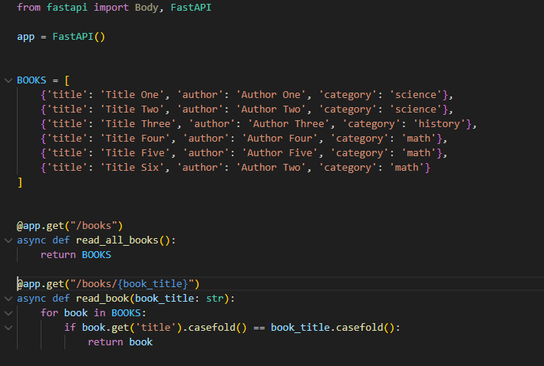
Books Project

